Slide 1





BEYOND · DUBAI · 2026
The UAE
Digital Tax Future
What comes after e-Invoicing
Archit Gupta
CEO & Founder

Slide 2


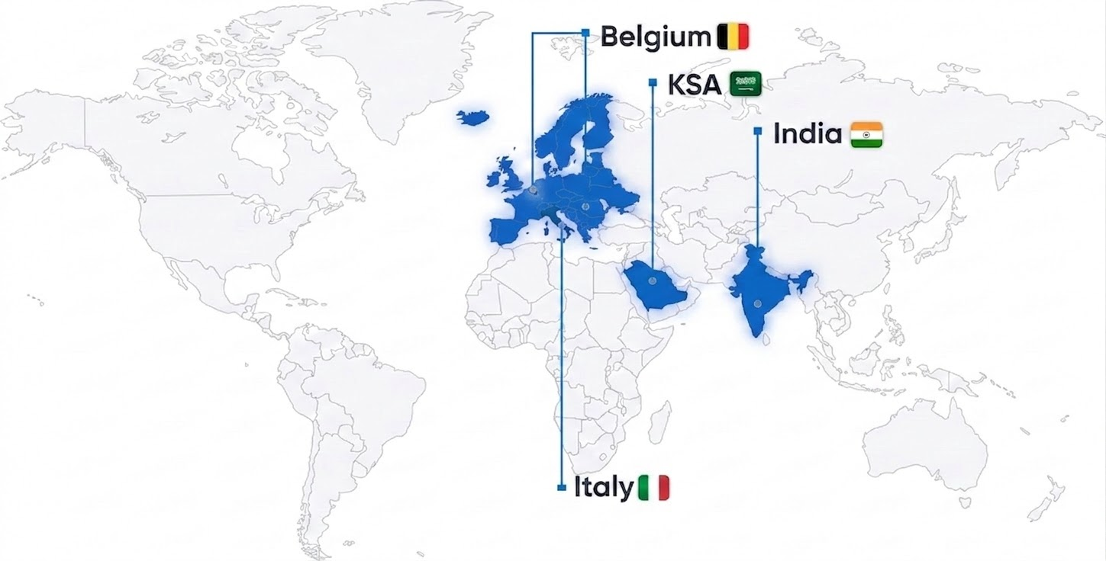
What the world has taught us about e-invoicing
KSA - b2c + VAT pre-fill audit
Leading the way in real-time B2C e-invoicing, & VAT pre-fill live. ZATCA cross-references e-invoice data against returns — mismatches trigger notices.
India - scale
12B+ invoices processed annually covering $2.4 trillion economy; 1 in 10 invoices flows via Cleartax
Italy - VAT gap: 20% → <10%
Audit scrutiny escalates fast once governments have invoice data
Belgium - PEPPOL
Complexity grows faster than non-specialists can absorb.
UAE is at the same turning point that KSA, Italy, Belgium, and India once faced. The decisions CFOs make today will define tomorrow’s finance
Notes:
KSA (Saudi Arabia)
AI-driven real-time invoice validations and anomaly detection were crucial in achieving over 99% first-pass acceptance rates under ZATCA’s e-invoicing mandate.
Self-learning compliance bots helped organizations adapt instantly to frequent ZATCA schema updates, minimizing expensive integration rewrites.
France
Introduction of machine-learning-based invoice format converters accelerated onboarding of diverse ERP and billing systems, drastically reducing manual mapping effort.
AI-powered reporting agents enabled seamless transition from periodic to continuous transaction controls (CTC) as France prepares for global interoperability.
India
At scale, AI clustering and fraud detection flagged suspect invoices in 12 billion+ transactions every year, helping reduce tax evasion and empowering government analytics.
Integration of natural language processing (NLP) enabled enterprises to surface insights from invoice notes/comments, automating GST reconciliation and dispute handling.
Brazil
Brazil’s real-time e-invoicing (NF-e) required AI to auto-classify complex product/service codes and validate tax compliance inline, enabling the government to recover over 58B USD in tax gaps since rollout.
AI-enabled credit risk analysis from standardized invoice data supported new supply chain financing models and SME lending.
Mexico
Over 90% of SMEs use AI-driven CFDI data extraction and validation to access digital credit, unlocking easier supply chain finance based on reliable, government-stamped documentation.
Machine learning algorithms trained on historical invoicing data auto-detect compliance gaps and generate recommendations for timely remediation.
EU
The adoption of AI-powered Peppol mapping and validation agents dramatically reduced integration time for cross-border e-invoicing partners, driving Europe towards full VAT gap closure.
Predictive analytics surfaced discrepancies in multi-country VAT submissions early, supporting CFOs in proactive audit preparation and regulatory response. Source: OECD/CIAT: Brazil: “Recovered over $58B in tax revenues through e-invoicing since rollout.”
Source: World Bank 2019: Mexico: “90% of SMEs use CFDI data to access credit lines and supply chain financing.”
Source: European Commission VAT Gap Report 2023 Europe: “EU estimates €134B VAT gap; e-invoicing expected to close a significant portion by 2030.”
India
12B+ invoices annually processed through the national GST e-invoicing system
Fraud reduced, tax transparency improved
Built foundation for cash flow visibility and AI-driven analytics
Brazil & Mexico
Closed billions in tax gap via real-time invoice reporting
Verified invoice data enabled supply-chain financing and better credit access
Strengthened trust between businesses and regulators
Europe
Moving toward cross-border interoperability & real-time reporting
CFOs gaining visibility into multi-country VAT compliance
Peppol adoption is setting the benchmark for France’s future interoperability

Slide 3


THE UNIVERSAL PATTERN
Every mandate follows the same arc.
The world is moving from filing tax to proving tax. In real time.
01
02
03
04
Mandate
Cross-check
Pre-fill
AI finance operations
Capture every transaction at source. Structured format. Real-time submission.
The authority matches your VAT returns against your e-invoice data.
Your VAT return is no longer yours to draft. The authority drafts it for you.
Discrepancies surface automatically. Penalties follow. No manual review.
ClearTax is building for this.

Slide 4



Is UAE ready for the Mandate arc?
Ready for Jan 1.
Not ready for what follows.
We asked 500+ finance leaders.
01
02
03
04
Mandate
Cross-check
Pre-fill
AI finance operations
73.3%
69%
64.8%
66.2%
Most are ready for the 1st Jan deadline
Not audit-ready for real-time exposure
As the authority cross-checks continuously, gaps become penalties before you can fix them.
Lack pre-submission validation
Errors aren't caught before submission, and it scales with volume. Wrong data in → wrong reporting out.
Cannot deliver machine-ready records in 48 hours
You are exposed to compliance risk today — before any new mandate takes effect.

Slide 5

THE FUTURE
GLOBALLY, HERE IS WHAT THE WINNERS DID DIFFERENTLY
Three architectural decisions, made before go-live.
01
02
03
Treat e-invoicing as its own layer
API-first, mandate-agnostic
Build for the agentic-AI future
Change your ERP, add a country, or absorb an acquisition — without rebuilding compliance each time.
One connector for every country. New mandates arrive as config, not code. Your team controls
the timeline.
Agents reconcile invoice ↔ GL ↔ VAT and handle the 95%. Humans see only the exceptions.
Notes:
For AI Data: AI is only useful in real life when it sits on a purpose-built Finance Data Lake. Mindset: Think AI As Leverage. Not Just Automation, AI is unlike traditional software. The way you purchase, implement, and how you reap benefits is very different

Slide 6
January 1st
isn't the finish line.
The decisions you make in the next few weeks shape the next 10 years.
21

Slide 7
Thank you.

